Slide 1


Concept of the Networking event on-site at the Biofach 2023
VOAA + CRED
30.01.2023

Slide 2
Content
Results of pre-brainstorming
Mailing process, analytics
Concept of the MM event
Agenda of the MM event
List of Co-exhibitors

Slide 3

PRE-BRAINSTORMING

Slide 4
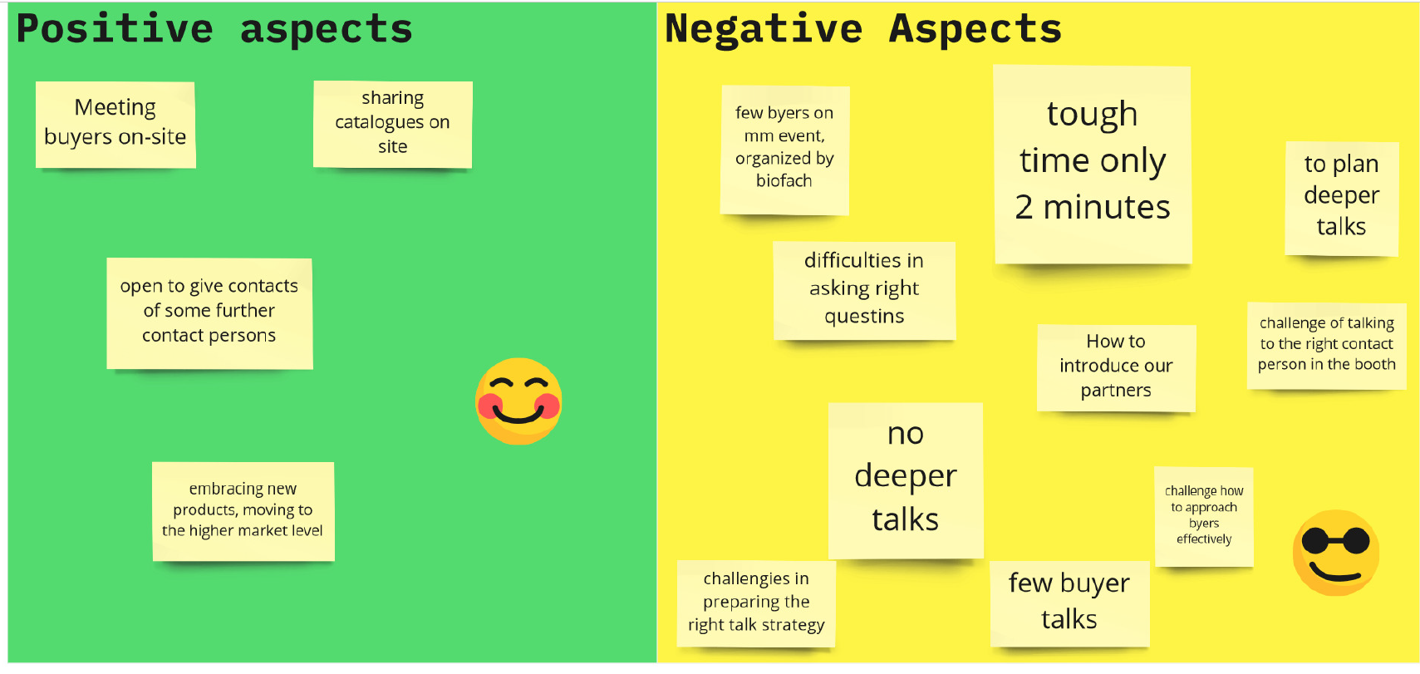
Follow Up on Biofach 2022

Slide 5
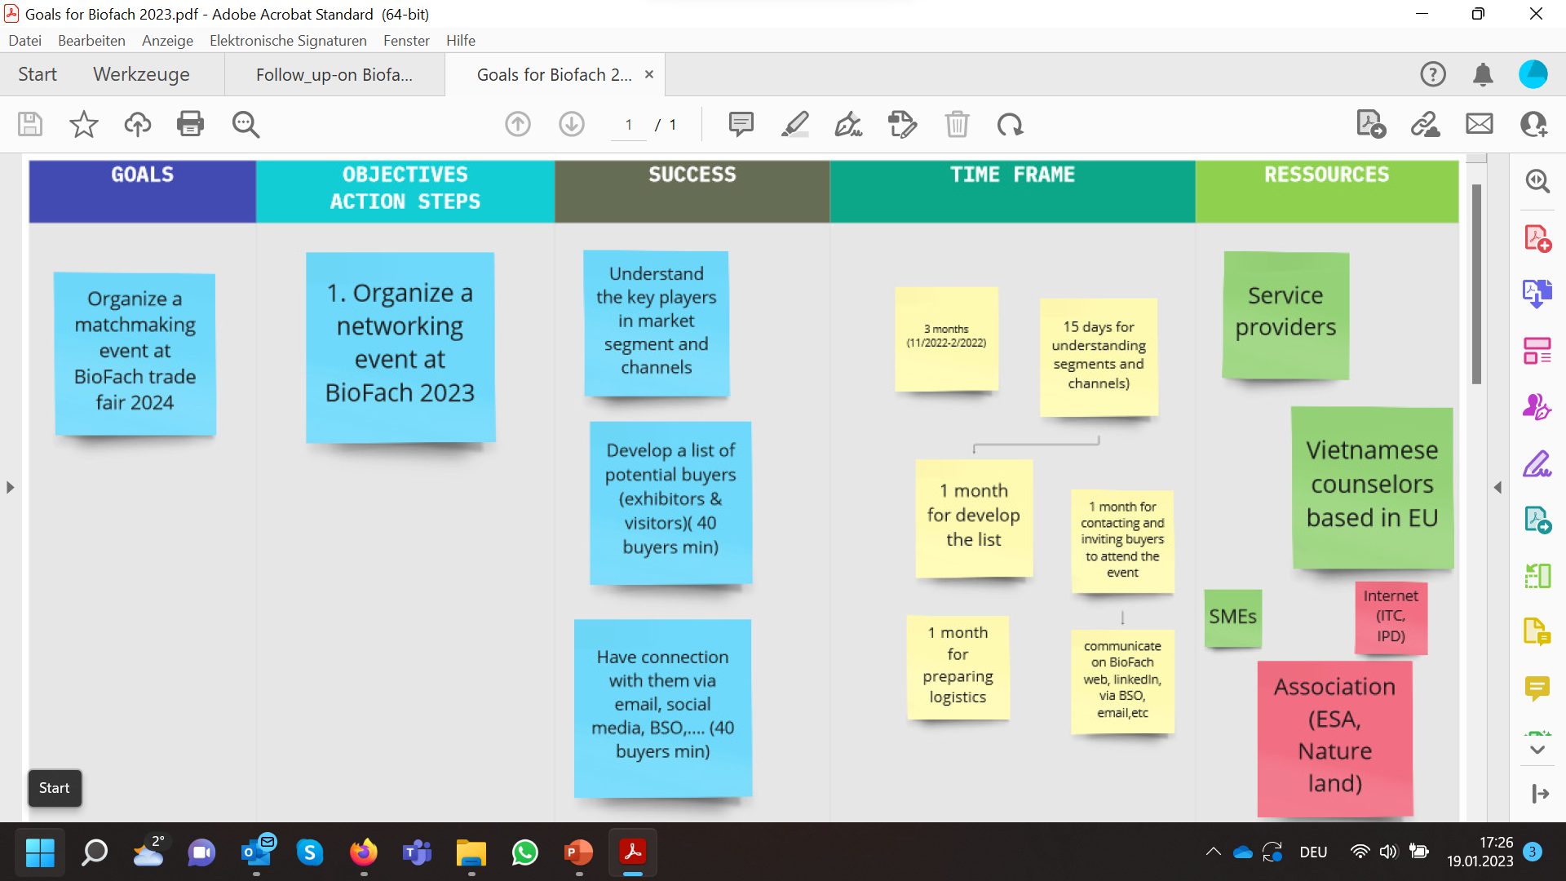
GOALS & OBJECTIVES FOR BIOFACH 2023: PART I

Slide 6
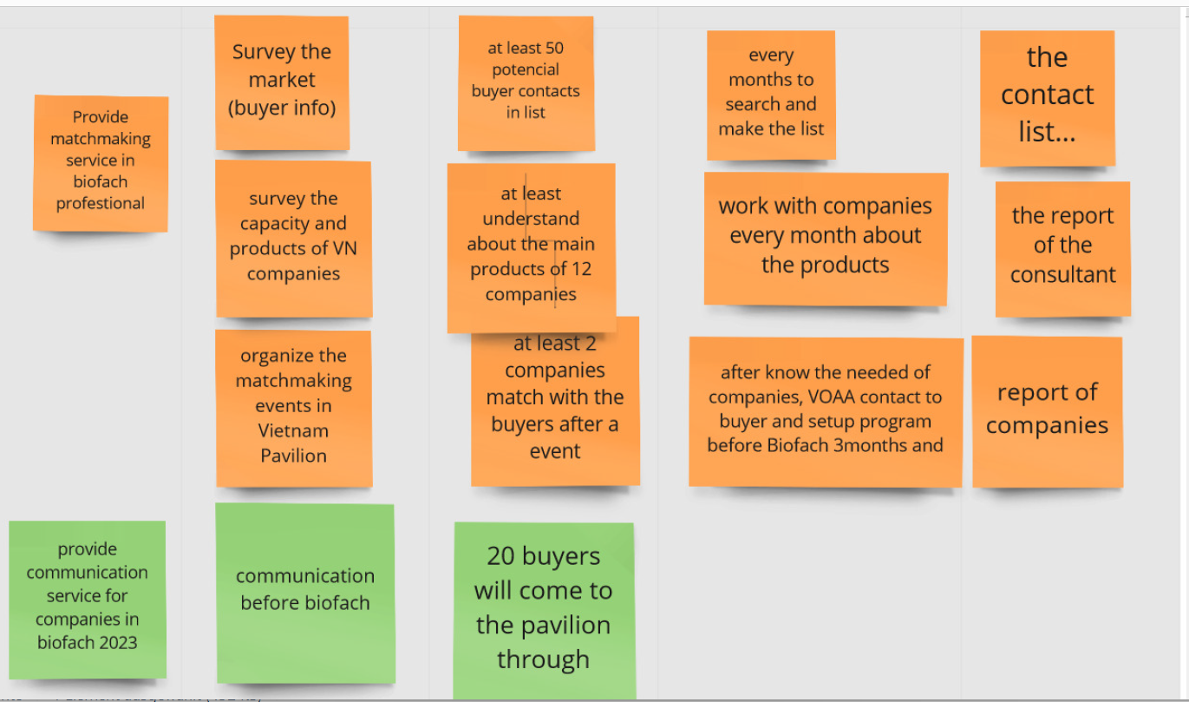
GOALS & OBJECTIVES FOR BIOFACH 2023: PART II

Slide 7
HOW TO IDENTIFY THE RIGHT POTENTIAL BUYERS
ONLINE PLATFORMS: BioFach, https://www.europages.com/, https://de.kompass.com/en, https://www.auma.de/en
Statistics from VOAA & CRED on:
      number of companies contacted: 54
      number of companies, that have responded after the first email: 3 (Spain, Netherlands, Switzerland)

Slide 8

Concept of the Networking event on-site at Biofach 2023

Slide 9

Concept of the Matchmaking event on-site
…….
DATES: 14/02/2023 & 16/02/2023
The scope of the event: Vietnam Organic Pavilion, Hall 2 - 121
The format of your event: networking
Role of VOAA/ CRED:
VOAA: facilator
CRED: supporter
Proflie of the event

Slide 10

Concept of the Matchmaking event on-site
3. The size of the planned event
# Seller: 10
# Buyer: 15-20
4. The target group of your event:
All type of European importers (spices, coconut, cashews, pulses, tea)
Exhibitors at the trade fair
5. The countries where you would like to export: European countries
Proflie of the event

Slide 11

Performance at the Biofach

Slide 12
AGENDA (The 1st day – 14.2.2023)
Time | Day I
10:00 -10:05 | Check-in/Registration of participants at the Vietnam pavilion: Hall 2 Booth 121
10:05 – 10:15 | Introduction/ Welcome speech.. Who we are and what we do VOAA introduction Overview of organic agriculture in Vietnam Short introduction of 10 exhibitors
10:15 – 10:25 | Tea show + Cashew show
10:25 – 11:30 | Meeting 101

Slide 13
AGENDA (The 2nd day – 16.2.2023)
Time | Day II
10:00 -10:05 | Check-in/Registration of participants at the Vietnam pavilion: Hall 2, Booth 121
10:05 – 10:15 | Introduction/ Welcome speech.. Who we are and what we do VOAA introduction Overview of organic agriculture in Vietnam Short introduction of 10 exhibitors
10:15 – 10:25 | Cashew show
10:25 – 11:30 | Meeting 101

Slide 14
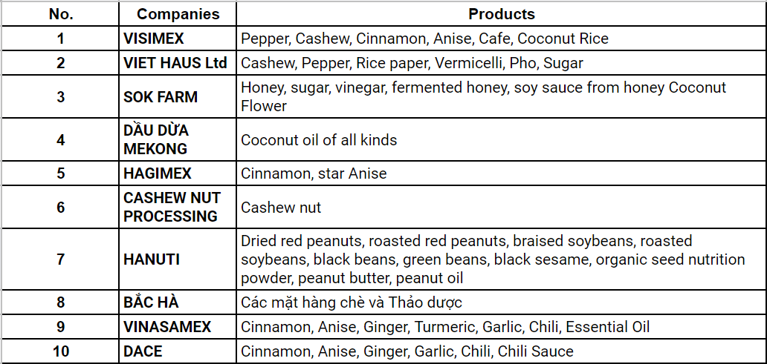
List of co-exhibitors:

