Slide 1
Support of Regional Economic Cooperation in Asia (SRECA)
Greater Tumen Initiative (GTI) Online Training Series “Proposal Writing & Project Management”
Soft Project proposals within GTI and GIZ SRECA Supports
17 March 2021, Mongolia

Slide 2
Brief Introduction of GIZ Support of Regional Economic Cooperation in Asia (SRECA) Programme

Slide 3
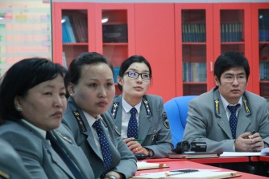
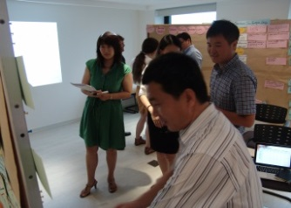
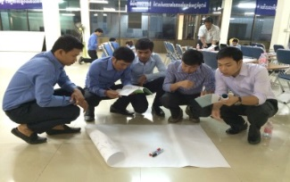
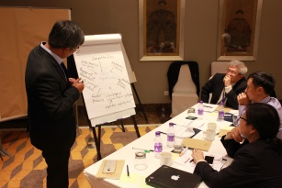
Support of Regional Economic Cooperation in Asia (SRECA)
Overall Goal
Economic cooperation and agricultural trade between selected neighbouring countries and China is strengthened
Focus Countries
Mongolia, Cambodia, Lao PDR, Viet Nam
Commissioned by
German Federal Ministry for Economic Cooperation and Development (BMZ)
Overall term
04/2019 – 03/2022
30 July 2019
Notes:
The objective of the project is to improve the conditions for regional and global trade in selected focus countries – Cambodia, Lao PDR and Viet Nam in the framework of ACFTA, and Mongolia in the framework of GTI – with the PR China, to ensure the equal inclusion of the countries’ interests in regional and global integration processes. Special focus is put on agricultural products.
The project thereby operates in three areas: 1) enhancing the access of small and medium enterprises (SMEs) to trade-related services; 2) strengthening the structures for cross-border (sub-)regional cooperation between the focus countries and China; 3) fostering regional and/or trilateral measures for knowledge exchange and experience among the focus countries and/or with China in the field of regional economic cooperation.

Slide 4
Regional Focus
Northeast Asia
Greater Tumen Initiative (GTI)
Supporting Mongolian public and private actors within regional cooperation in GTI
Cooperating with the GTI Secretariat as well as its Boards/Committees
Southeast Asia
ASEAN-China Cooperation
Supporting Cambodia, Lao PDR and Viet Nam within the ASEAN-China Free Trade Area (ACFTA)
Cooperating with respective public and private actors
30 July 2019
Notes:
The government of Mongolia has committed itself to engage in regional economic cooperation and integration. Mongolia is a member of the GTI, an intergovernmental cooperation mechanism among PR China, Mongolia, Republic of Korea, and the Russian Federation. The main executing agency is the GTI Secretariat. GTI aims at strengthening economic and technical cooperation to attain greater growth and sustainable development in Northeast Asia (NEA), and especially the Greater Tumen Region (GTR). In particular, GTI focuses on the priority areas of transport, trade and investment, tourism, energy, and agriculture with the environment as a cross-cutting sector. Specialised boards and committees coordinate the cooperation between member countries. Each sector’s board/committee is composed of officials from relevant line ministries and state agencies of the member countries.

Slide 5
Overview Mongolia Component
Rationale
Foster regional economic cooperation and agricultural trade between Mongolia and China (incl. Chinese institutions as development partners)
Objectives
Improving access to trade-related services for local SMEs in Mongolia especially including female entrepreneurs (e.g. export guidelines)
Fostering regional knowledge exchange between the focus countries and/or with China (e.g. SPS) and public-private dialogue
Piloting trilateral cooperation activities in the field of regional economic cooperation between China – Germany – Mongolia
30 July 2019
Notes:
to improve the capacity and inclusion of Mongolian stakeholders to better engage in regional economic integration processes (especially regarding agricultural trade facilitaton, private sector enhancement, and cross-border cooperation). In doing so, the project aims to include especially China as an economic and development partner for the benefit of Mongolian economic development.

Slide 6
Activities 2019-2022 Mongolia Component
1
Mongolia
2
Regional
Compiling export guidelines with MNCCI, MoFALI, MCGA, etc.
Capacity building and public-private dialogue trainings on agri-trade
Engaging GTI Mongolia Stakeholders in regional cooperation process under the GTI
E-learning courses and explanatory videos on export and trade
Capacity Building within GTI as well as with Chinese partners like ATPC
Regional exchange among focus countries and/or China
Studies and reports on market access for Mongolian businesses to China
Initiating triangular cooperation between China-Germany-Mongolia
Führungskraft
Talent
Kein T.
Talent
Page 4

Slide 7
Soft project proposals within GTI

Slide 8
Brief Overview of GTI
The Greater Tumen Initiative (GTI) (originally known as the Tumen River Area Development Programme) is an intergovernmental cooperation mechanism among four countries: China, Mongolia, Republic of Korea and Russian Federation, supported by the United Nations Development Programme (UNDP)
The GTI focuses on the priority areas of transport, trade and investment, tourism, agriculture, energy, with environment as a cross-cutting sector.
The GTI has become an effective platform for regional economic cooperation, expanding policy dialogue, improving business environments and contributing to peace and stability in NEA. In addition, the GTI works closely with important international partners to jointly promote the region.
The GTI continues to strengthen regional cooperation through policy dialogue and the implementation of priority projects. It has established strong partnerships with regional governments, international organisations and the private sector to jointly promote cooperative activities in NEA.

Slide 9
GTI Funding sources
Member states
GTI Special Account by Chinese Government
Common Fund
ROK-UNDP Trust Fund
External sources (co-financing with international organisations, development banks, etc.)

Slide 10
Mongolian project proposals to GTI since 2018 and their current status
Project Name | Sector | Timeframe | Key Partners | Status | Proposed Party/Note
“Youth4Climate-Training&Network of Emerging Climate Leaders in GTI Region | Environment | 2019-2020 | All members | To be further developed | By MET
A Regional Consultative Meeting To Promote Trade Facilitation Of Agricultural Products In The Greater Tumen Region | Agriculture | 2019-2020 | Mongolia and other members | Not Approved | By MOFALI

Slide 11
Mongolian project proposals to GTI since 2018 and their current status
Project Name | Sector | Timeframe | Key Partners | Status | Proposed Party/Note
Promotion of SMEs’ Production by Enhancing the Implementation of Inward and Outward Processing Procedures | Customs Sub Committee | 2020-2021 | ROK and other members | Approved by NCs and CC 2019 | By Mongolian Customs General Administration postponed due to COVID-19
Capacity Building on Organic Agroindustry in Asia | Agriculture | 2021- | All members | To be further developed (concept for now) | By MOFALI

Slide 12
Mongolian project proposals to GTI since 2018 and their current status
Project Name | Sector | Timeframe | Key Partners | Status | Proposed Party/Note
Improving Cross-border Labour Movement in the Greater Tumen Region | LCC | 2021-2022 | All members | Under discussion | By Dornod
System dynamic analysis on economic advantages of GTI countries | RIN | 2021 | All members | Under development (merge with other proposal) | By ISS To be merged with ROK proposal "Joint Research on Enhancing the Regional Cooperation of the Greater Tumen Region (GTR) in Finance Sector"
Study of a new potential railway route in the Great Tumen region | Transport/logistics | 2021 | All members | Under discussion | By Ministry of Road and Transport Development of Mongolia

Slide 13
Challenges of Mongolian project proposals
Not specific respectively focused enough
Failing to address concepts regarding issues that all member countries want to solve
Lacking to highlight joint benefits in the region involving all member countries
Too big in scope (exceeds financing capacity/budget of members)
Do not secure funding resource within Mongolia

Slide 14
SRECA Supports

Slide 15
SRECA Supports
Funding online training series and follow-ups on “Project proposal writing” together with Applicatio Training Agency
Supporting review and comments of the project proposals based on requests
Technical support and some funding for Mongolian side if projects are implemented.

Slide 16
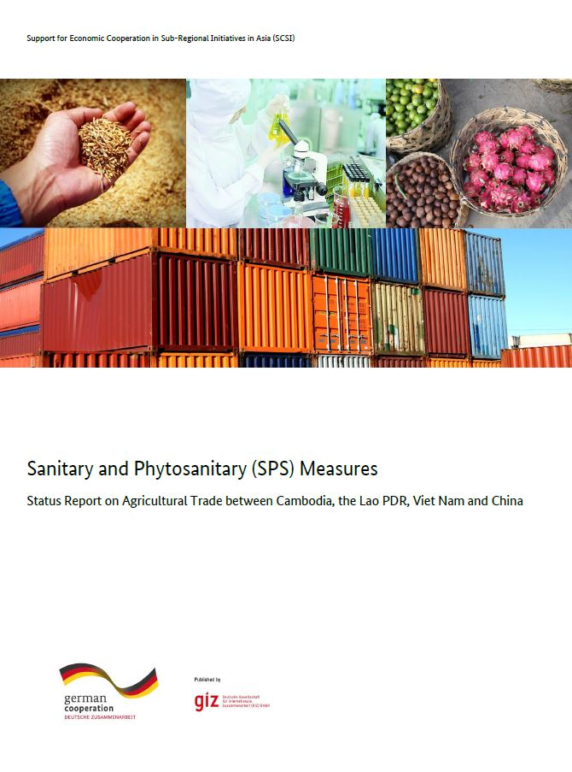
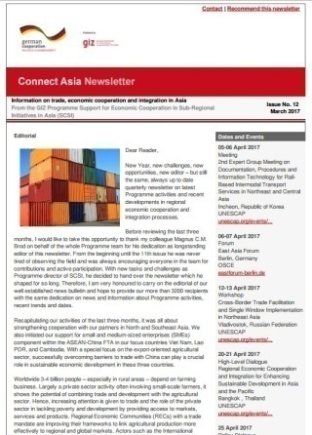
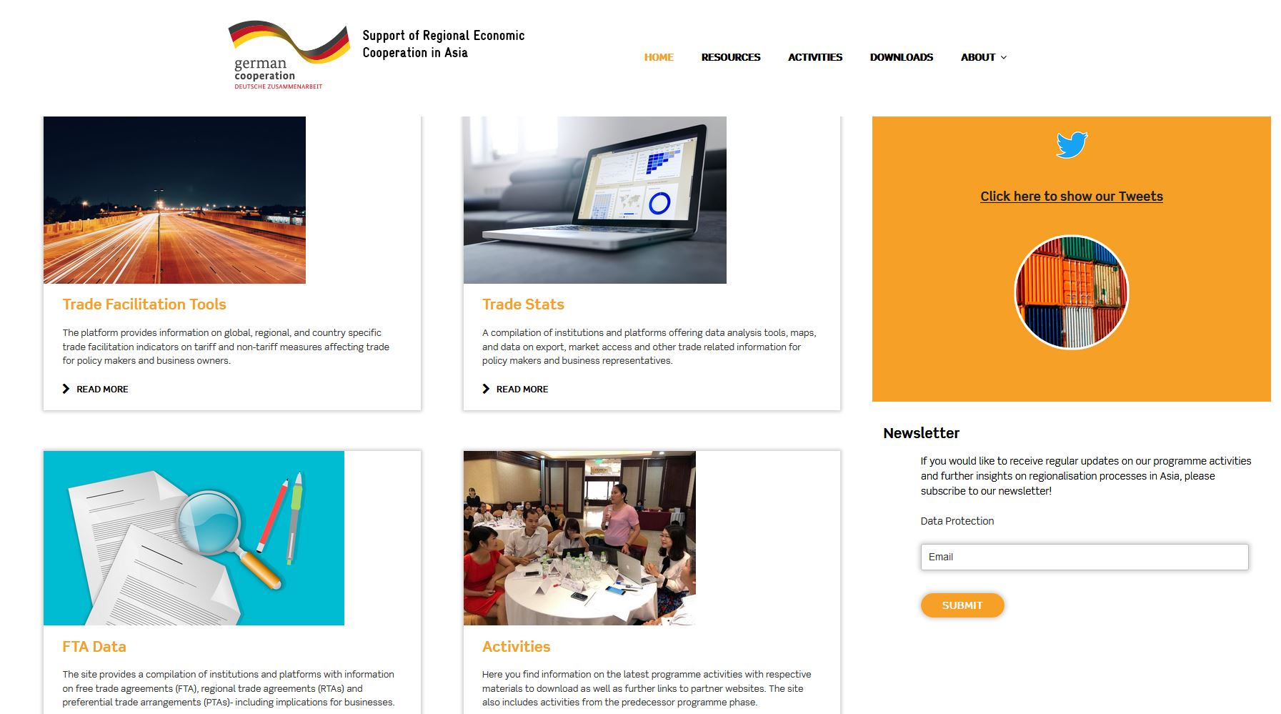
Learn more about our work
Blog, documentations and studies: connecting-asia.org
Quarterly newsletter: Connect Asia
Social Media: Twitter
Sharing PPTs etc. via SlideShare
Page 8
30 July 2019

Slide 17
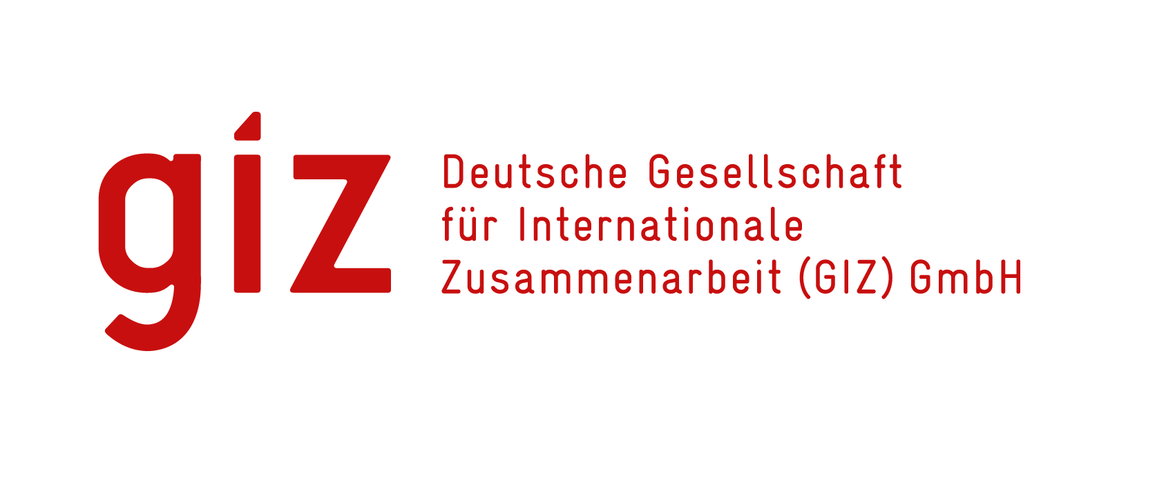
Thank you for your attention!
Implemented by
Page 9

Slide 18
Responsible: Florian Miß
Author:
Sambuunyam Zolzaya
Design/layout: GIZ / GIZ SRECA
Photo credits/sources: GIZ SRECA
URL links: Responsibility for the content of external websites linked in this publication always lies with their respective publishers. GIZ expressly dissociates itself from such content.
On behalf of German Federal Ministry for Economic Cooperation and Development (BMZ)
GIZ is responsible for the content of this publication.
Support of Regional Economic Cooperation in Asia (SRECA)
Deutsche Gesellschaft für Internationale Zusammenarbeit (GIZ) GmbH
Tayuan Diplomatic Office Building 1-14-1
Liangmahe Nanlu No 14
Beijing 100600, Chaoyang District
PR China
T +86 10 8532 4025 F +86 10 8532 5774
E florian.miss@giz.de I www.connecting-asia.org / www.giz.de
Page 10

