Slide 1
Innovation in Food and Agriculture
Main Findings from OECD’s Country Reviews
Shingo Kimura
OECD Trade and Agriculture Directorate
ATPC Seminar, Beijing

Slide 2
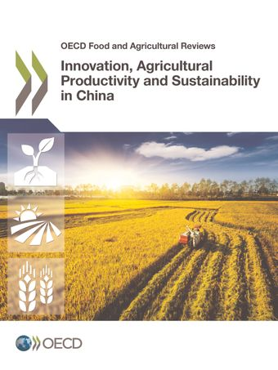
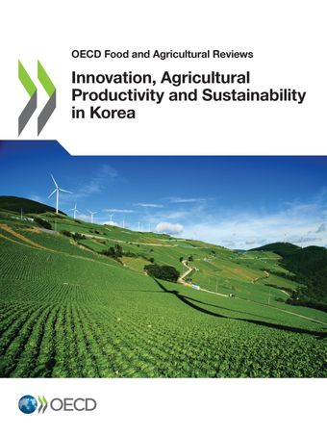
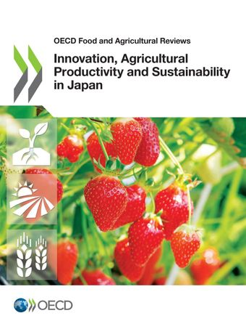
OECD applied the G20-initiated analytical framework for improving agricultural productivity and sustainability to review policies

Slide 3
Challenges and opportunities for agriculture and rural development in East Asia
Macro-economy
Demographic trend
Agricultural sector
Concentration of production to large-scale operator and high value-added products
Global
Technology and data driven agriculture
Income growth led by non-farm sectors
Integrated regional and global value chain
Rural-urban income disparity
Constraints in natural resource
Climate change

Slide 4
OECD reviews show that governance of agricultural innovation system is key
Innovation in agriculture is increasingly depends on technologies developed outside the sector
Innovation became a highly interactive process of collaboration between a variety of actors
The challenge is to make the agricultural innovation system more responsive to needs and more effective in generating innovative solutions
This is much beyond R&D policy, the whole policy and market environment matters for innovation
Fostering the skills of farmers to innovate and engage with other stakeholders
Notes:
government, research, education, extension, companies, producer groups, farmers, non-governmental organisations, markets (consumers)

Slide 5
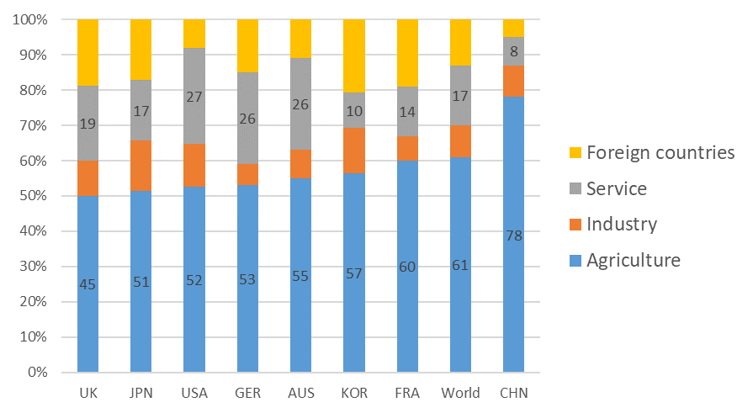
What is the source of value-added in agricultural products?
Sources of value added in the final demand in the agriculture, 2014
Sources: : Adapted from: Greenville, J., K. Kawasaki and M. Jouanjean (2019), "Value Adding Pathways in Agriculture and Food Trade: The Role of GVCs and Services", OECD Food, Agriculture and Fisheries Papers, No. 123, OECD Publishing, Paris

Slide 6
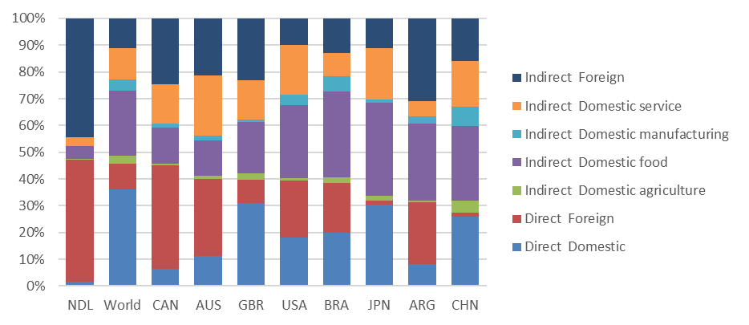
Where is the value-added by agricultural sector ends up?
Destination of value added by the agriculture, 2014
Sources: : Adapted from: Greenville, J., K. Kawasaki and M. Jouanjean (2019), "Value Adding Pathways in Agriculture and Food Trade: The Role of GVCs and Services", OECD Food, Agriculture and Fisheries Papers, No. 123, OECD Publishing, Paris

Slide 7
Developing policy and market environment
more conducive for innovation
Less directive policy, focusing beyond agricultural production
Further shift to non-commodity specific producer support
More role for private input and service markets
Enhance farmers’ role in managing normal business risk
Ensure a level playing field among agricultural input and service providers
Increase the role of private extension services on areas of public interest and policy advice

Slide 8
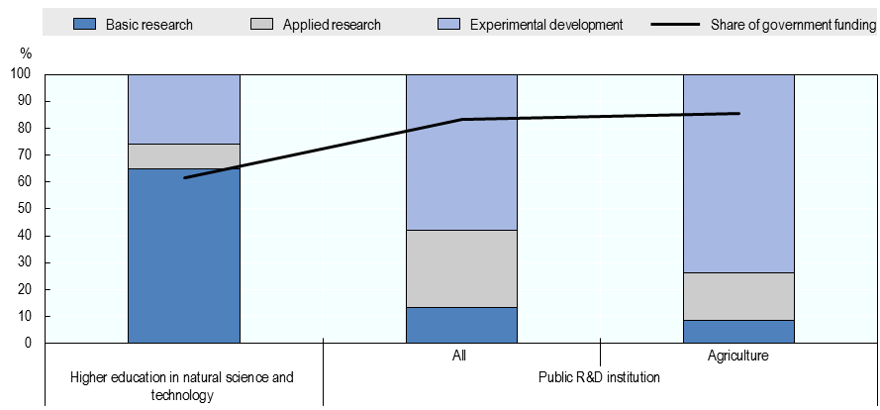
Public agricultural R&D should concentrate more on the pre-competitive area of research
R&D expenditure by research area and funding source, 2013
Source: China Statistical Yearbook on Science and Technology and China Agricultural Science and Technology Statistics,
Notes:
Last area of policy is agricultural innovation system.
China is now the largest investor to public agricultural R&D system in monetary term and developed the world largest and most decentralized public agricultural R&D network.
Here I am highlighting the research area of R&D expenditure of university and public R&D institutions in China.
In agricultural public R&D institutions, more than 70% of expenditure go to experimental development. The share is higher in agriculture.
The dominance of public R&D institutions narrow the expansion of private R&D activities and it is sometimes difficult for researchers in public R&D institutions to commercialise their technology.

Slide 9
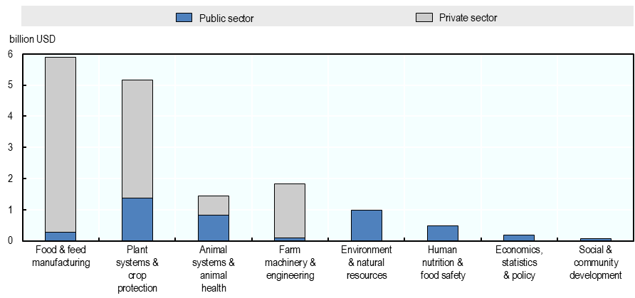
Public R&D investment in United States concentrates in the areas private sectors would underinvest
Funding share in different areas of agro-food R&D, 2013
Source: USDA

Slide 10
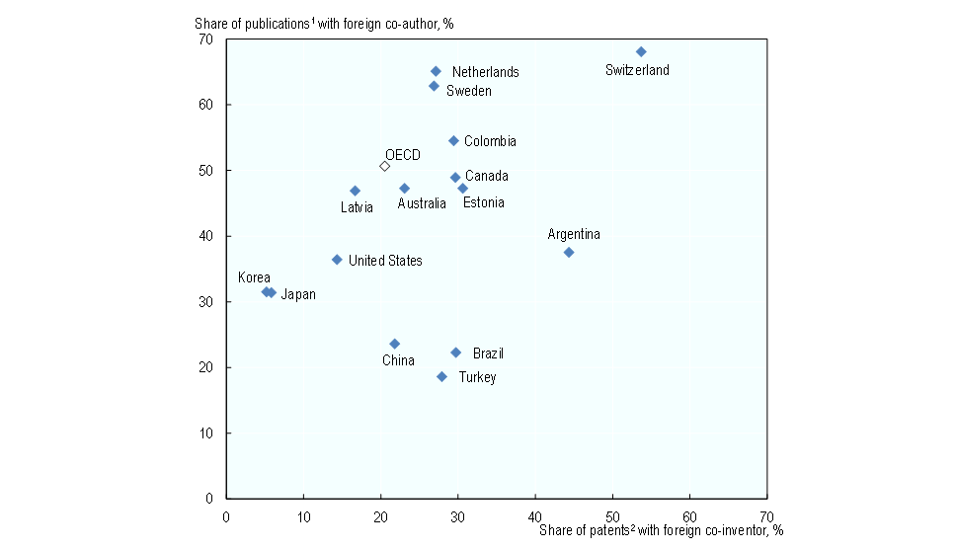
International research collaboration strengthens own agricultural innovation system
International co-operation in agro-food R&D, 2007-12
Agro-food outputs with foreign partners as a share of total agro-food outputs
Notes:
ADD Japan

Slide 11
Example of producer’s proactive engagement in agricultural innovation process
 | R&D | Human capital development
Netherlands | Industry set the research agenda and government match the fund | Industry and government co-finance the professional education in agriculture. Producers actively participate in education
Australia | RDC collects 0.5% of production value from producers, which is matched by the government. RDC decides research agenda | Skill priorities and action plan was identified by industry council
Sweden | Farmers federation set up the fund for demand-driven R&D, in which 1/3 is funded by the government. | Industries engages in education in agricultural universities
Argentina | 226 regional consortia set R&D agenda and perform R&D, hiring technicians | 10-12 producers meet every month and share experiences, which is open to non-members
Notes:
ADD Japan

Slide 12
Developing more collaborative and participatory agricultural innovation system
More proactive industry participation in innovation process
Introduce co-funding schemes for agricultural R&D with producer organisations
Cross-sectoral collaboration in agricultural innovation
Focus agricultural R&D on pre-competitive research areas with a medium-long-term perspective and on areas not specifically tied to commercial production
Increase funding for collaboration, and co-funding with the private sector and foreign researchers
More integration with general innovation systems
Participation in agricultural education to avoid mismatch of skill supply

Slide 13
Suggested directions of policy reform
Supply oriented policies to guide production decision and technological choice
Demand oriented policies to address producer’s management constraints and expand business opportunities
Sector specific policies and institutions to isolate agriculture
Economy-wide policies to connect agriculture to competitive technologies and skills outside the sector
Segmented policies to support environmentally friendly farming
Integrated policies in which all the producers commit to the improvement of environmental performance
Notes:
Considering the changes of these situations, the report is suggesting broadly three directions of reform
Supply oriented policies (policy focusing on domestic market equilibrium, supply driven innovation system focusing on government R&D and extension system)
These supply orient policies create less incentive for innovation at the farm level
Demand oriented policies that address producers management constraints and expand business opportunities. The type of support that business oriented farmers is different. New technology and skills , risk management tools and opportunity to participate in the innovation process
Second point is more integration of agriculture with other sectors. Traditionally agriculture has been treated differently from other parts of the economy based on the assumption that agriculture is dominated by small scale family farms. Institutions such as Agricultural cooperatives, Agricultural Bank,
But link with outside agriculture becomes important
Third, improvement of sustainability of agriculture has been an objective of agricultural policy, but the policy was rather focus on supporting a small segment of environmentally friendly farming. Weak message that improving environmental performance is something all the producers need to commit.
Sustainability policy objective needs to be more integrated with all parts of agricultural policy

Slide 14
Contact us
We look forward to hearing from you!
Access all of the information from the Trade & Agriculture Directorate at:
www.oecd.org/tad
You can reach us via
e-mail by sending your message to the following address:
tad.contact@oecd.org
We invite you to connect with us on Twitter by following:
@OECDagriculture
Notes:
Contact us template agriculture - 1

